Slide 1
Glyphs Achievements Screen Design

Slide 2

Wireframe
Achievements
Flick of the Wrist
5/50
Perform 50 flick gestures.
x5
Drag Royalty
75/500
Perform 500 drag gestures.
x10
You Spin Me Round
1000/5000
Perform 5000 rotate gestures.
x20
Digital Maraca
5/50
Perform 50 colour swaps.
x5

Slide 3
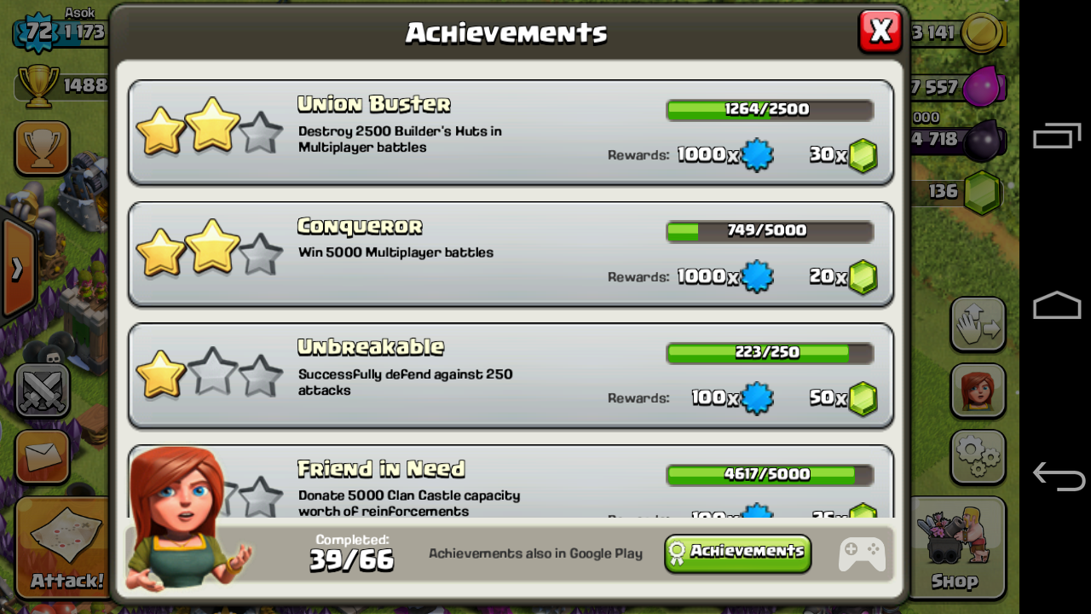
Polished Example
Progress bar
Completed Tier
Indicator
Reward Indicator
Achievement
Title
Achievement
Description
Scrollable Frame
Social Media API Link
Clash of Clans

